Slide 1
Kubernetes
Introduction
and
Ansible:

Slide 2

Introduction
Kubernetes
and
Ansible:

Slide 3

you’re preparing a 10-course meal with different cuisines

Slide 4
Some guests are vegetarian, some are gluten-free, and some have nut allergies
The Secret Sauce to Smooth Operations
The catch:
you’re preparing a 10-course meal with different cuisines

Slide 5

Halfway through the party, more people show up unexpectedly, and you need to scale up the food and seating
The Secret Sauce to Smooth Operations
The catch:
Some guests are vegetarian, some are gluten-free, and some have nut allergies
you’re preparing a 10-course meal with different cuisines

Slide 6


and your oven breaks down mid-party
The Secret Sauce to Smooth Operations
The catch:
Halfway through the party, more people show up unexpectedly, and you need to scale up the food and seating
Some guests are vegetarian, some are gluten-free, and some have nut allergies

Slide 7

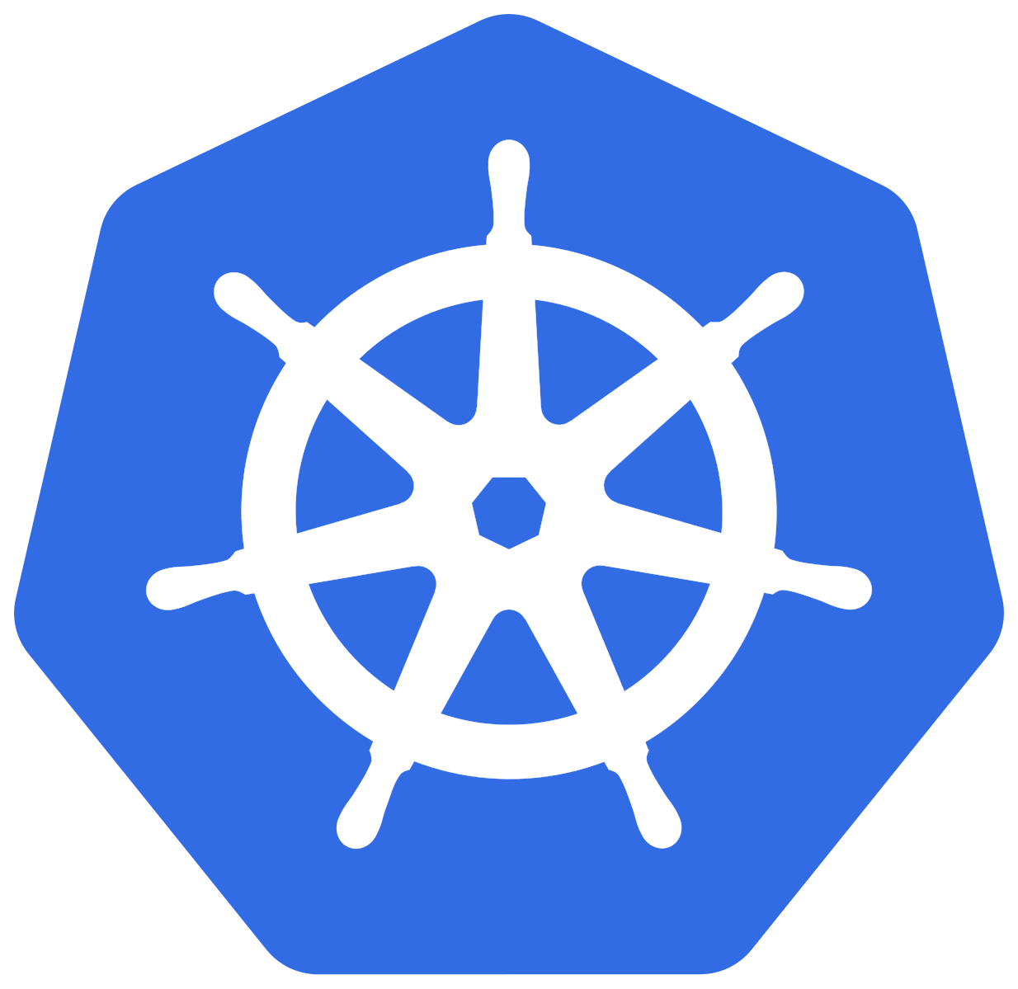
The Secret Sauce to Smooth Operations
The catch:
and your oven breaks down mid-party
Halfway through the party, more people show up unexpectedly, and you need to scale up the food and seating

Slide 8
The Secret Sauce to Smooth Operations
and your oven breaks down mid-party
The catch:

Slide 9

The Secret Sauce to Smooth Operations
It automatically manages all the dishes (applications), making sure they’re cooked, served, and scaled to perfection—even when unexpected guests arrive or oven breaks. It ensures everything runs smoothly, no matter what happens.
master chef and event coordinator

Slide 10
The Secret Sauce to Smooth Operations
It automates all the repetitive tasks—chopping vegetables, preheating the oven, setting the table—so you don’t have to do everything manually. It ensures consistency across every dish, so every guest gets exactly what they ordered.
prep kitchen and recipe book

Slide 11
Kubernetes
So many questions
and
Ansible

Slide 12
So many questions
What is it? Why even bother? It’s really complicated

Slide 13
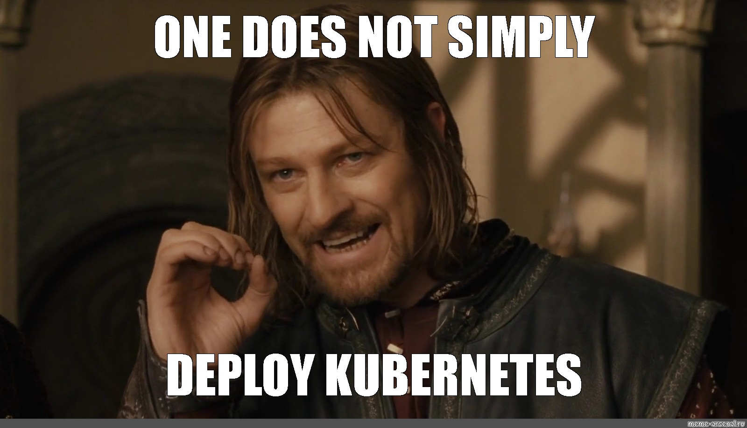
So many questions
What is it? Why even bother? It’s really complicated

Slide 14
What is it? Why even bother? It’s really complicated

Slide 15
Kubernetes
So many questions
and
Ansible

Slide 16
Kubernetes
Orchestration tool
Used for large scale deployments

Slide 17
Orchestration tool
Used for large scale deployments
It excels in production

Slide 18
Used for large scale deployments
It excels in production
Used by extensively by big tech

Slide 19
It excels in production
Used extensively by big tech
Why k8s*?

Slide 20
Why k8s?
Used by extensively by big tech
Why k8s*?
Let’s imagine we have an application
* Short for Kubernetes

Slide 21

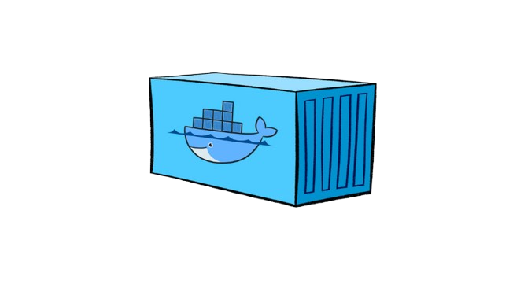
Why k8s?
Let’s imagine we have an application
Why k8s*?

Slide 22
Why k8s?
Why k8s*?
Let’s imagine we have an application

Slide 23
Why k8s?
Why k8s*?
And it’s running on so many containers

Slide 24
Why k8s?
Why k8s*?
And it’s running on so many containers
At a certain point the management of the containers becomes really difficult and chaotic

Slide 25
Why k8s?
Why k8s*?
And it’s running on so many containers
At a certain point the management of the containers becomes really difficult and chaotic
Kubernetes manages the orchestration of these containers perfectly

Slide 26
Why k8s?
:)))))
Before diving deeper, let’s get familiar with some concepts
At a certain point the management of the containers becomes really difficult and chaotic
Kubernetes manages the orchestration of these containers perfectly

Slide 27
Why k8s?
:)))))
Before diving deeper, let’s get familiar with some concepts
Pods, nodes, clusters
Kubernetes manages the orchestration of these containers perfectly

Slide 28
Pod
Before diving deeper, let’s get familiar with some concepts
Pods, nodes, clusters

Slide 29

Pods, nodes, clusters
Pod

Slide 30
Pods, nodes, clusters
Pod
smallest and simplest unit in the Kubernetes object model

Slide 31
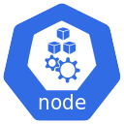
Pods, nodes, clusters
smallest and simplest unit in the Kubernetes object model
It represents a single instance of a running process
Pod

Slide 32
Pods, nodes, clusters
It represents a single instance of a running process
smallest and simplest unit in the Kubernetes object model

Slide 33


Single or multiple containers
ephemeral
Has its own IP
address
It represents a single instance of a running process

Slide 34
Single or multiple containers
ephemeral
Has its own IP
address
It represents a single instance of a running process

Slide 35
Single or multiple containers
ephemeral
Has its own IP
address

Slide 36
Physical or virtual machines that provide the resources to run applications

Slide 37
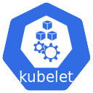
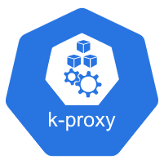

Physical or virtual machines that provide the resources to run applications

Slide 38
Physical or virtual machines that provide the resources to run applications

Slide 39






Master node
Worker node
Cluster
The foundation of the K8s architecture
smallest and simplest unit in the Kubernetes object model

Slide 40
Cluster
Master node
Worker node
smallest and simplest unit in the Kubernetes object model

Slide 41
Master node
Worker node

Slide 42
Cluster
Master node
Worker node
smallest and simplest unit in the Kubernetes object model

Slide 43
Worker node
*
Master node
Api server
Front-end for the control plane
Exposes the K8s api to perform operation on the cluster
* Control plane is the same as master node

Slide 44
Worker node
*
Master node
Scheduler
Assigns Pods to Nodes based on resource availability and constraints
* Control plane is the same as master node

Slide 45
Worker node
*
Master node
Controller manager
Runs controllers that regulate the state of the cluster (e.g., Node Controller, Replication Controller)
* Control plane is the same as master node

Slide 46
Worker node
*
Master node
Cloud Controller manager
handles cloud provider-specific logic, enabling seamless integration with underlying cloud infrastructure
* Control plane is the same as master node

Slide 47
Worker node
*
Master node
etcd
Highly available key value store for all the cluster data
* Control plane is the same as master node

Slide 48
worker node
Kubelet
agent that runs on each node in the cluster. It ensures that containers are running in a Pod.
Worker node

Slide 49
Service Types
worker node
K8s proxy
clusterIP
NodePort
Exposes the service on th cluster internal ip address
Exposes the service on a static port on the node’s ip address
Ingress controller
Maintains network rules on nodes. These rules allow communication to Pods from network sessions inside or outside the cluster
LoadBalancer
Exposes the service externally using a cloud provider's load balancer
(not really a service type) but a really advanced and a smart way to route traffic and provide loadbalancing but it’s hard to setup
Worker node

Slide 50

Service Types
clusterIP
NodePort
Exposes the service on th cluster internal ip address
Exposes the service on a static port on the node’s ip address
Ingress controller
LoadBalancer
Exposes the service externally using a cloud provider's load balancer
(not really a service type) but a really advanced and a smart way to route traffic and provide loadbalancing but it’s hard to setup
Worker node

Slide 51
clusterIP
NodePort
Exposes the service on th cluster internal ip address
Exposes the service on a static port on the node’s ip address
Ingress controller
LoadBalancer
Exposes the service externally using a cloud provider's load balancer
(not really a service type) but a really advanced and a smart way to route traffic and provide loadbalancing but it’s hard to setup

Slide 52





Used to automate the deployment and management of systems
Steps to automate a deployment

Slide 53
It can be applied to set up a Kubernetes cluster efficiently
Used to automate the deployment and management of systems
Steps to automate a deployment

Slide 54
Playbooks are files that contain a list of tasks to be executed on machines
It can be applied to set up a Kubernetes cluster efficiently
Steps to automate a deployment

Slide 55
Ansible installs necessary software like Docker and kubeadm on nodes
Playbooks are files that contain a list of tasks to be executed on machines
It can be applied to set up a Kubernetes cluster efficiently

Slide 56
It initializes the master node to create the Kubernetes cluster
Ansible installs necessary software like Docker and kubeadm on nodes
Playbooks are files that contain a list of tasks to be executed on machines

Slide 57
Ansible runs commands to add worker nodes to the cluster
It initializes the master node to create the Kubernetes cluster
Ansible installs necessary software like Docker and kubeadm on nodes

Slide 58
It installs networking plugins to enable communication between nodes
Ansible runs commands to add worker nodes to the cluster
It initializes the master node to create the Kubernetes cluster

Slide 59
It installs networking plugins to enable communication between nodes
Ansible runs commands to add worker nodes to the cluster

Slide 60

Step by step K8s cluster deployment
inventory
ssh
push
Master node
Worker node
playbook
It installs networking plugins to enable communication between nodes

Slide 61
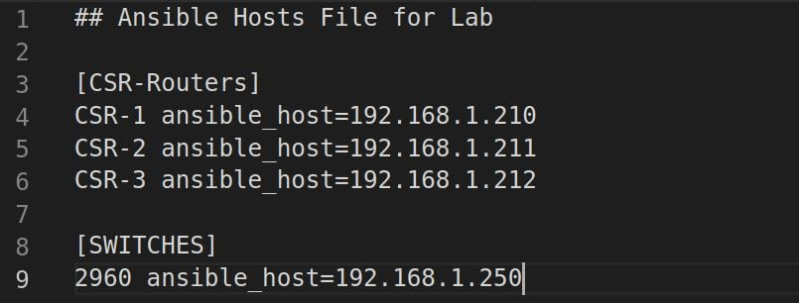
Step by step K8s cluster deployment
inventory
It installs networking plugins to enable communication between nodes

Slide 62
Step by step K8s cluster deployment
inventory
ssh
push
Master node
Worker node
playbook
It installs networking plugins to enable communication between nodes

Slide 63
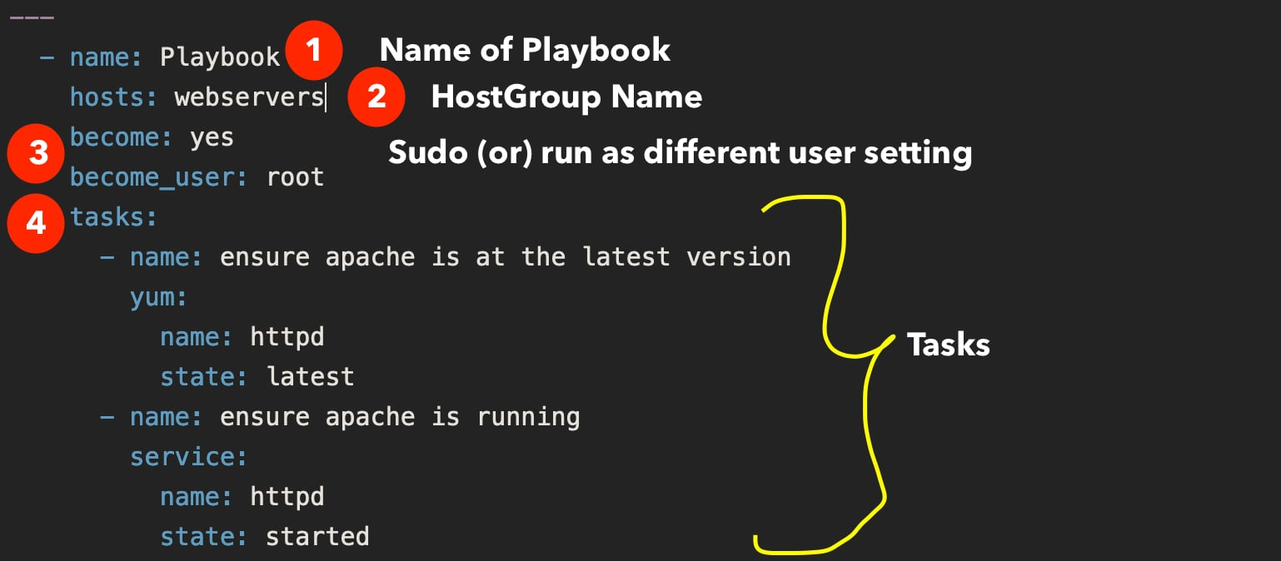

Challenge
Step by step K8s cluster deployment
playbook
nodes have consistent OS settings, networking, and dependencies

Slide 64
Challenge
nodes have consistent OS settings, networking, and dependencies

Slide 65
Solution
Challenge
nodes have consistent OS settings, networking, and dependencies
Playbooks to enforce setup. Roles and variables to manage different OS versions efficiently.

Slide 66

Challenge
Solution
Container Network Interface plugin required.
Misconfigured networking
Automate CNI plugin installation
Validate connectivity after deployment.
nodes have consistent OS settings, networking, and dependencies
Playbooks to enforce setup. Roles and variables to manage different OS versions efficiently.

Slide 67
Solution
Challenge
Container Network Interface plugin required.
Misconfigured networking
Automate CNI plugin installation
Validate connectivity after deployment.

Slide 68



Challenge
Solution
Expired or misconfigured TLS certificates can break cluster communication.
Use Kubeadm to manage certificates
Ansible Vault to encrypt secrets.

Slide 69
Solution
Challenge
Expired or misconfigured TLS certificates can break cluster communication.
Use Kubeadm to manage certificates
Ansible Vault to encrypt secrets.

Slide 70
Thank you

